Slide 1


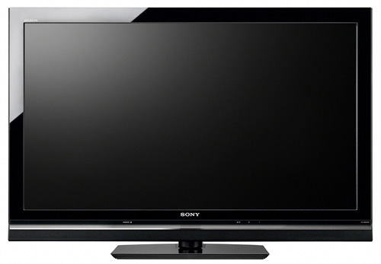
Assembly
.EXE
.DLL
Source Code
C#
Source Code
C++
Assembly
Native
.exe
AlterNative
.NET executable
App1?
Native executable
App1.exe

